Slide 1

SIZE GUIDE UI/UX ENHANCEMENT
ELISHA LEE
UI/UX DESIGNER
April 17, 2020

Slide 2
ELISHA LEE – UI/UX DESIGNER
AGENDA
UI/UX Design Workflow
Lucky Brand Analysis & Pain Points
Competitor Analysis
Questions
Solution & Wireframe
Three Months Roadmap

Slide 3
ELISHA LEE – UI/UX DESIGNER
UI/UX DESIGN
WORKFLOW

Slide 4
UI/UX DESIGN WORKFLOW
ELISHA’S WORKFLOW
SOLVE THE PROBLEMS
Analyze competitors
Find solutions
Discuss with Dev. Team
Survey or Interview*
*May skip depending on schedule or scope
DEVELOP & QA
Development
Conduct QA for UI
Conduct QA for UX/Function
Usability tests
Figure out bugs
START
01
ANAYSIS
02
RESEARCH
03
WHAT
04
PERFORM
05
WHEN
DEFINE
Define project area
Analyze current UI/UX
Find the paint points
Gather requirements
CREATE
User Flow (UX Flow)
Wireframes
Style Guide
UI Design
Prototype
Design Iteration
DEPLOY
Track usage
Review metrics
A/B Test

Slide 5
SIZE GUIDE UI/UX ENHANCEMENT
LUCKY BRAND
ANALYSIS

Slide 6
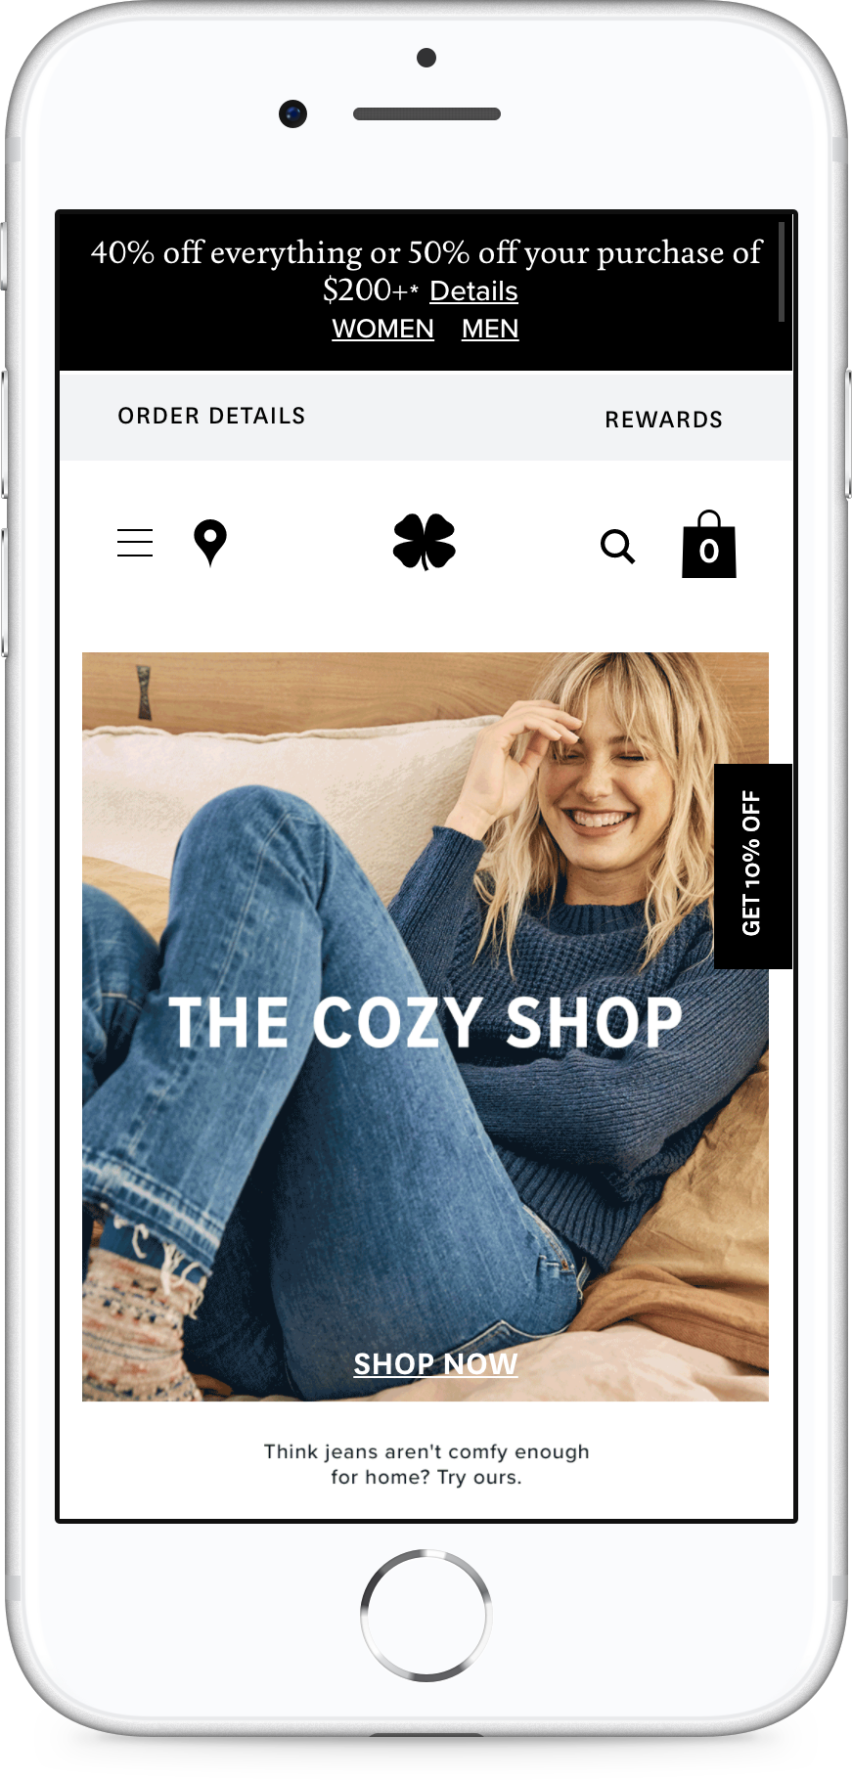
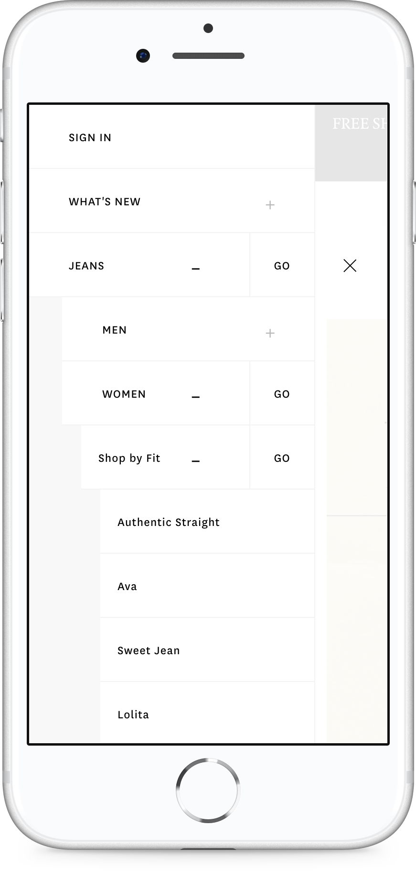
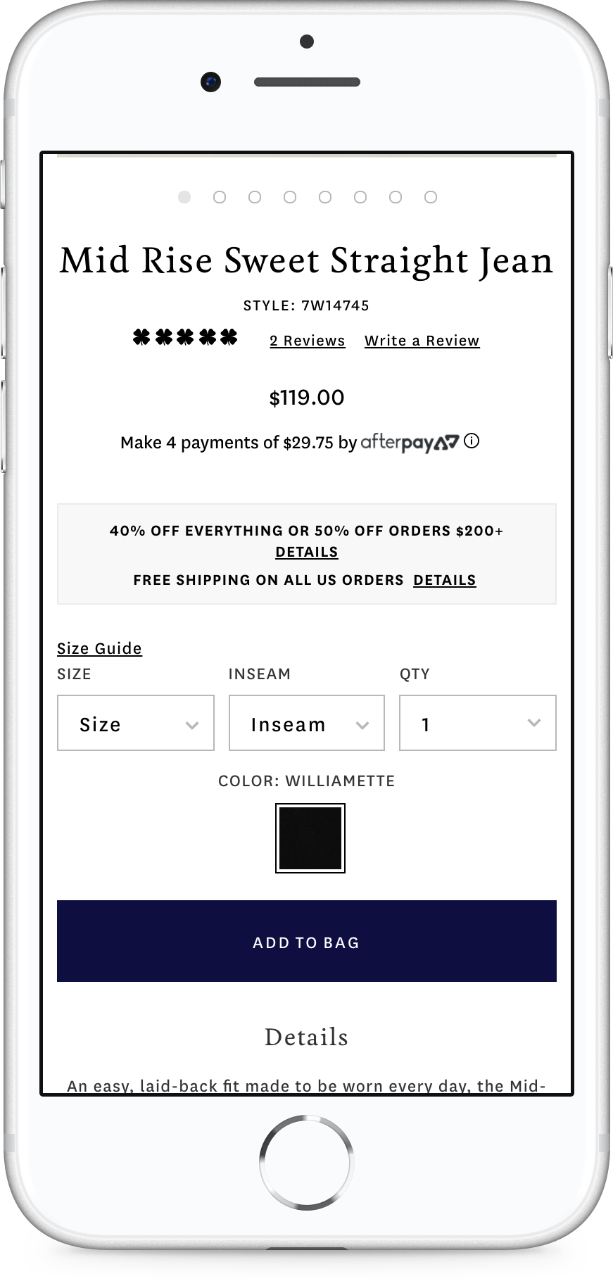
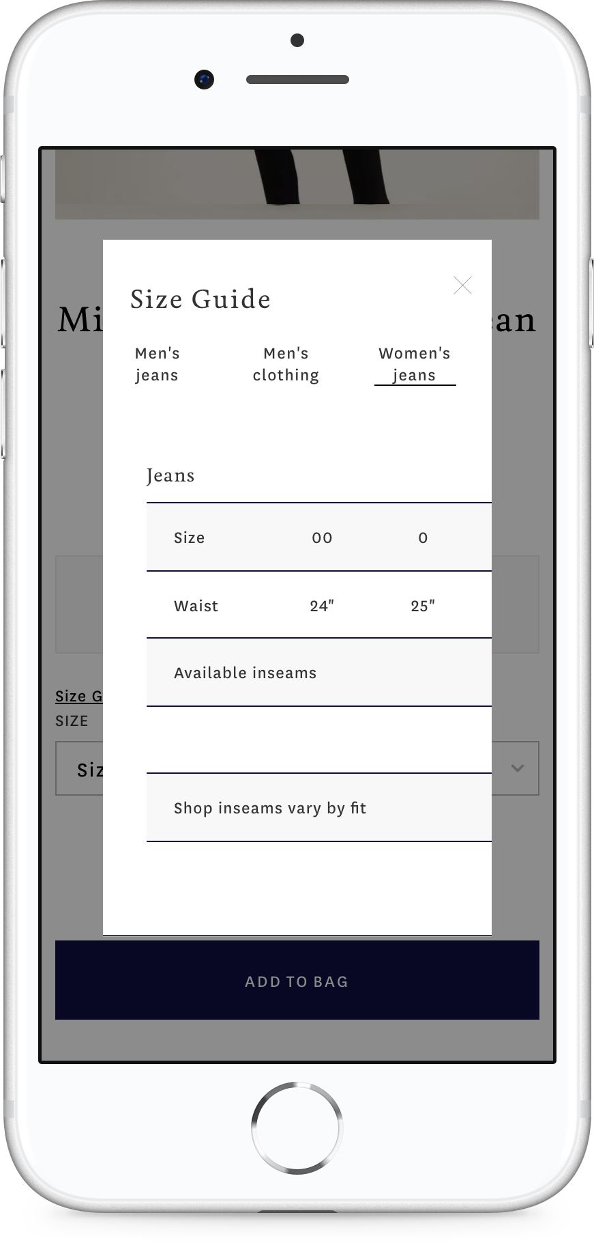
LUCKY BRAND ANALYSIS
CURRENT SIZE GUIDE FLOW

Slide 7
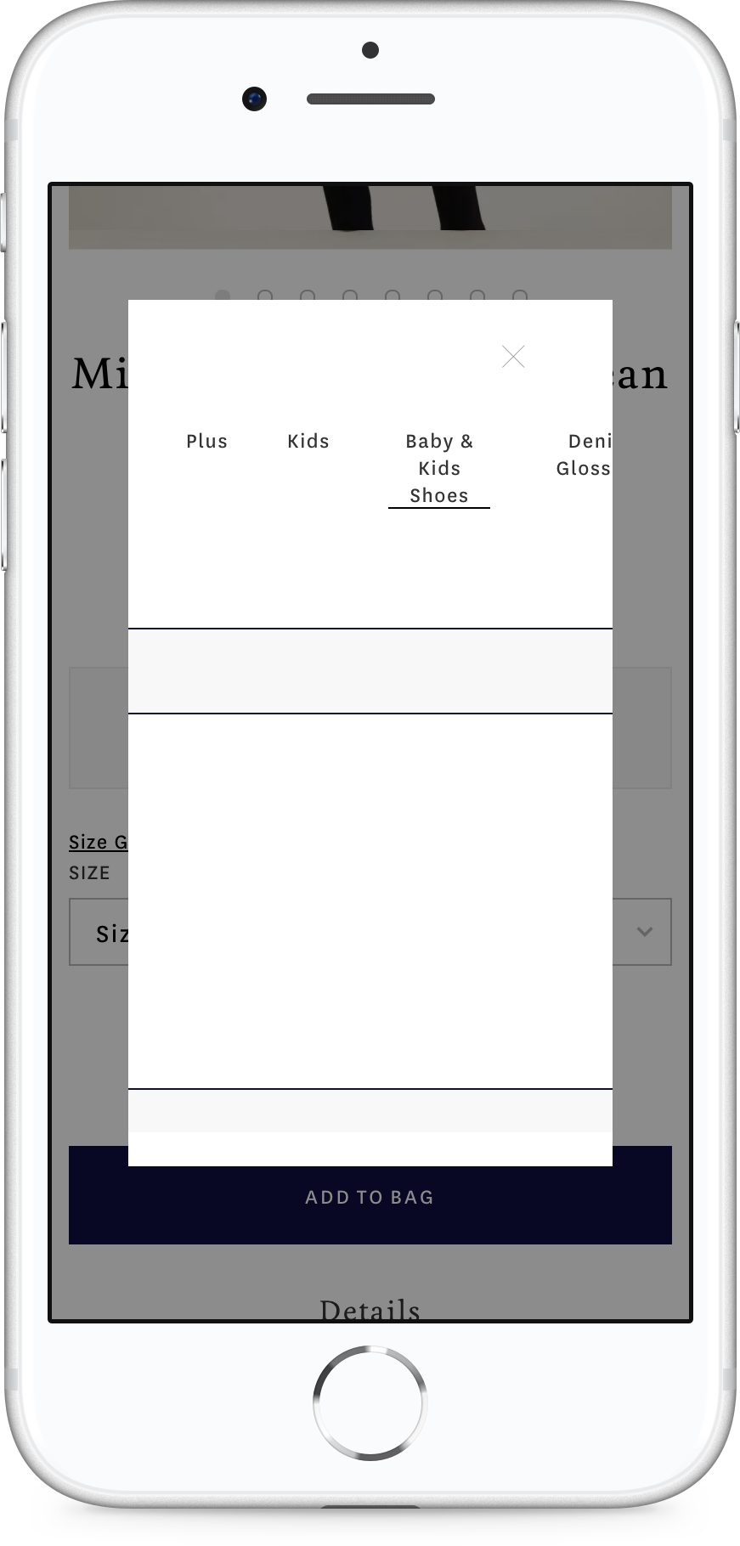
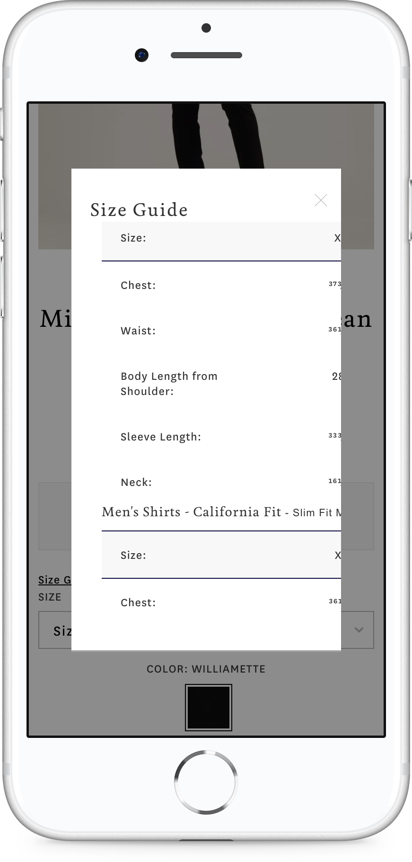
LUCKY BRAND ANALYSIS
ANALYZE MOBILE SIZE GUIDE
UI PERSPECTIVE
Unnoticeable “X” icon
Font legibility
Selected tab menu is unnoticeable
Misalignment and inconsistent space
UX PERSPECTIVE
Unclickable modal background
Scrollable modal popup with product detail contents
Selected tab menu is hidden when swiping contents
”Denim Glossary” is not related with size guide
“Men’s Jeans” is missing information
DEV. PERSPECTIVE
“Women’s Jeans” size is showing first on all products by default
Blue border outline on the touched area
Contents don’t reset position to the left side whenever tab menu is selected

Slide 8
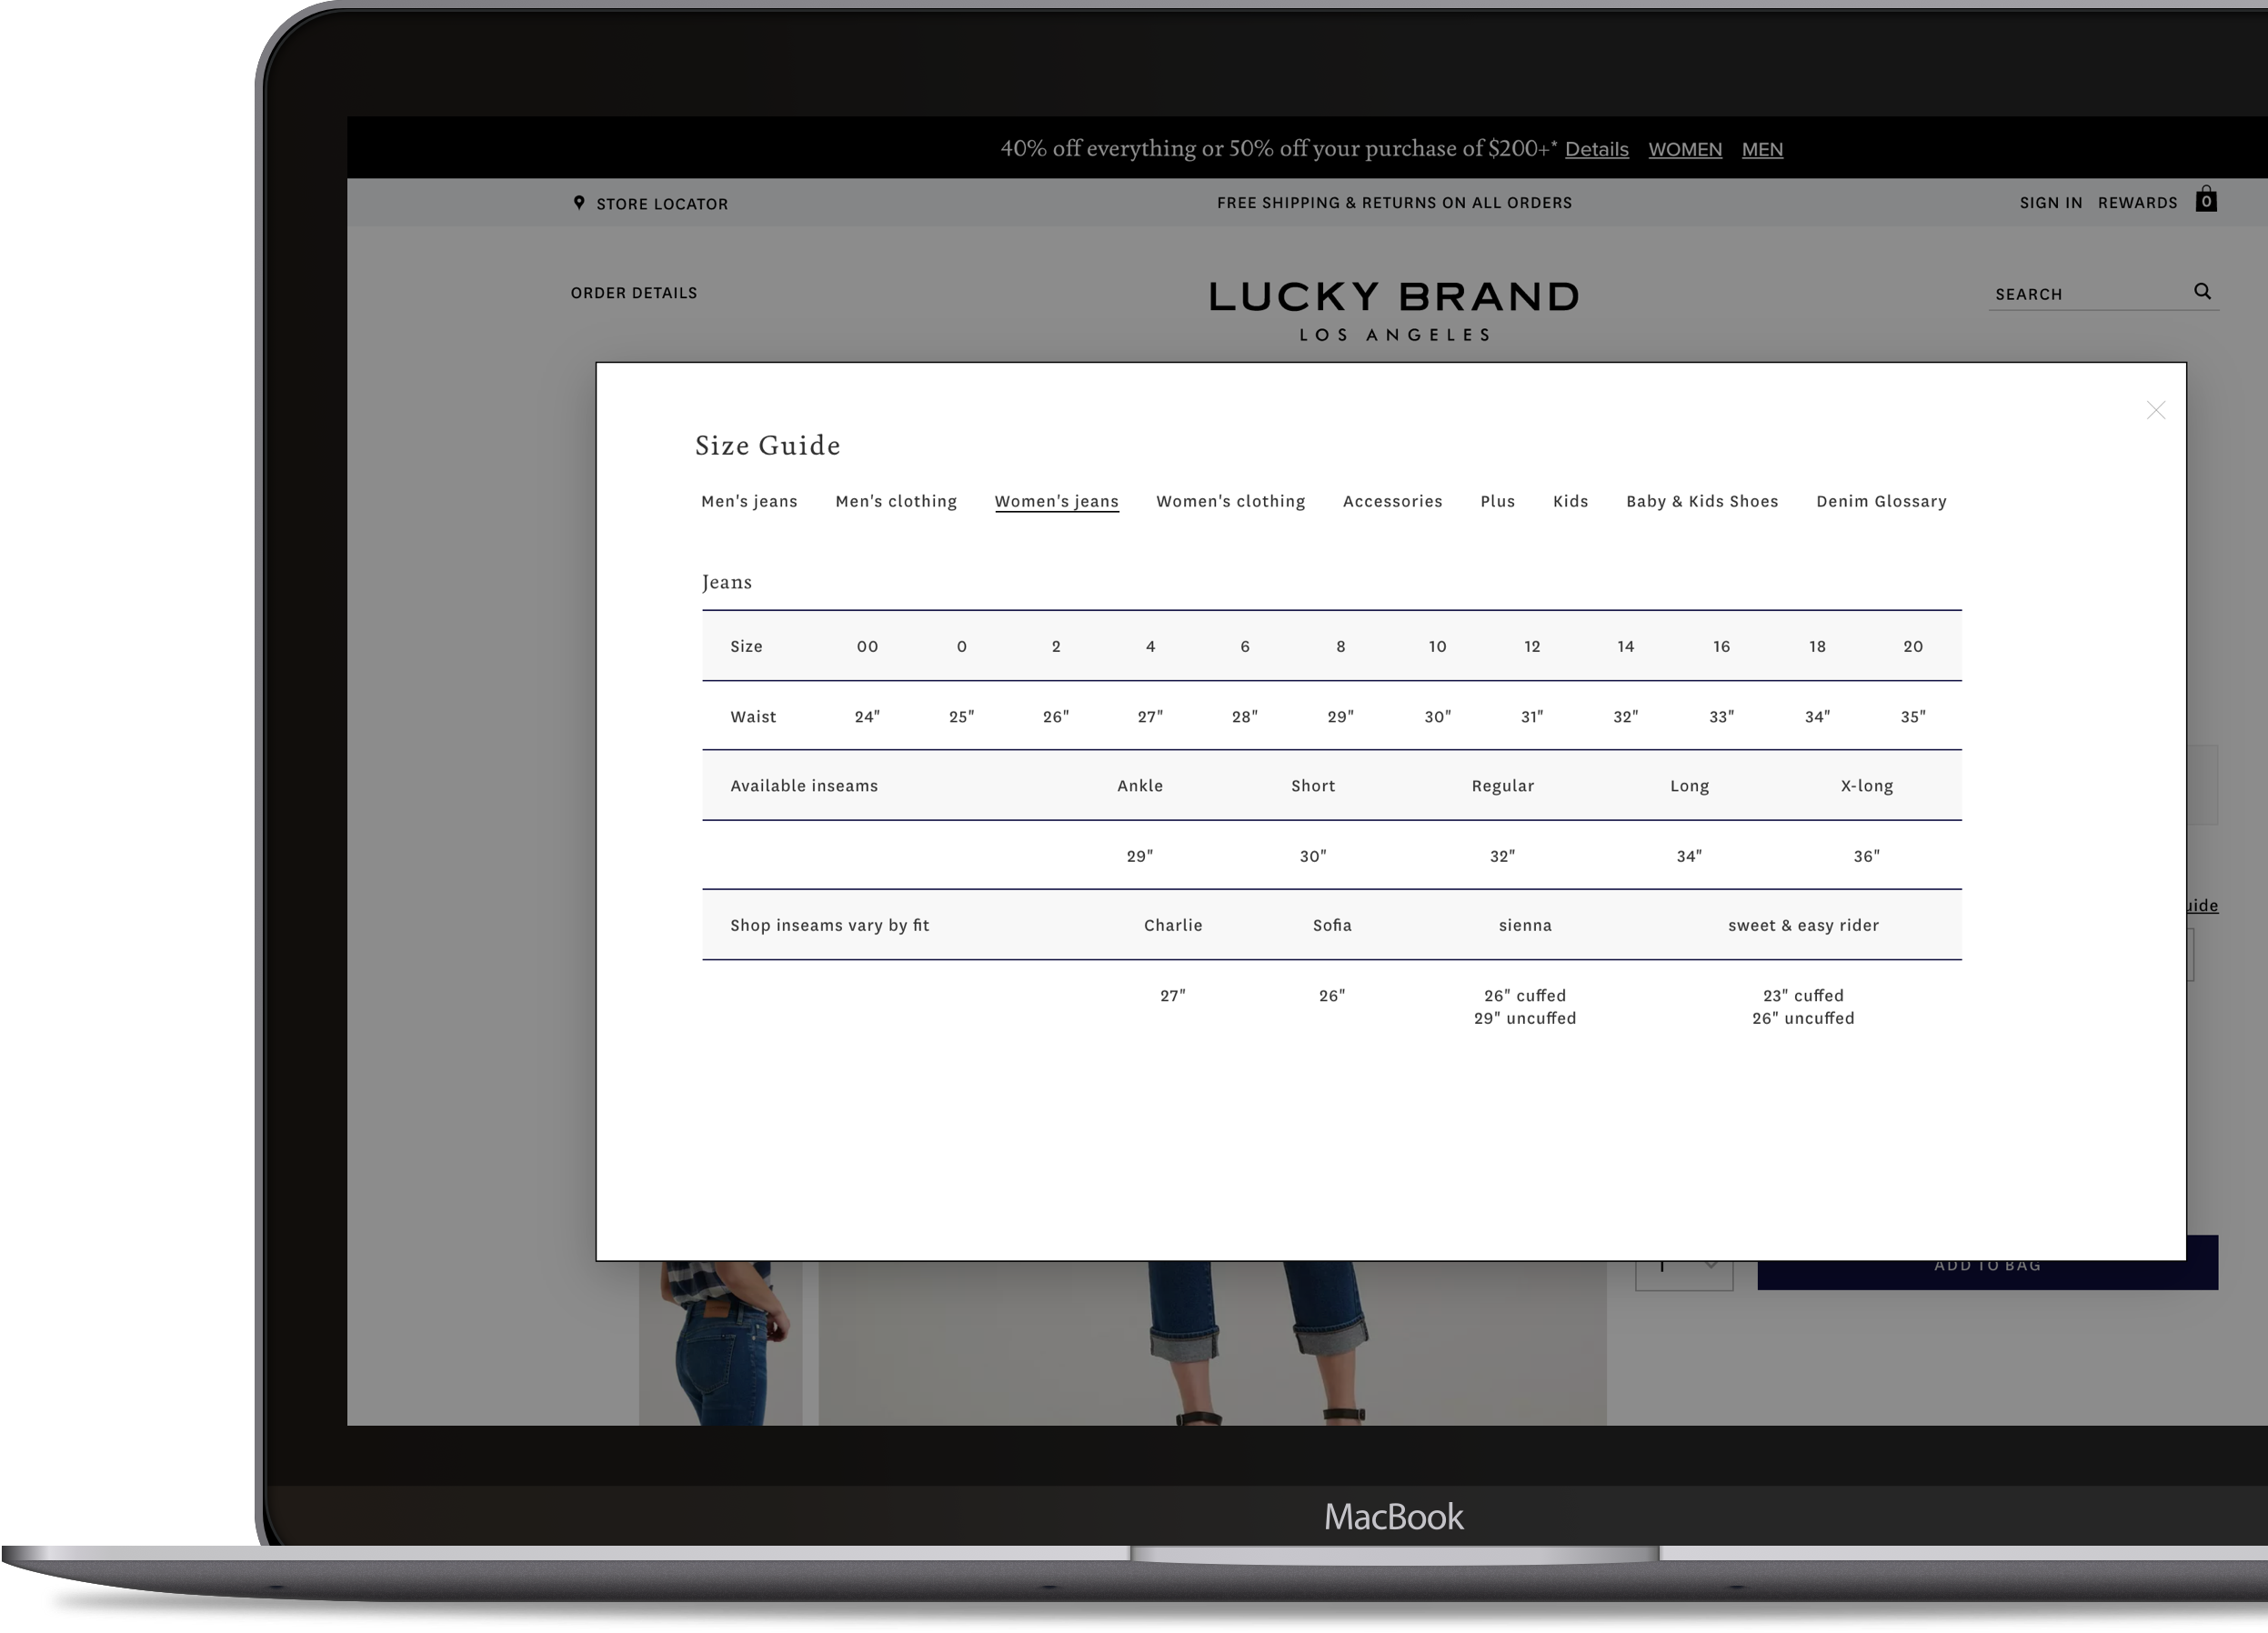
LUCKY BRAND ANALYSIS
ANALYZE DESKTOP SIZE GUIDE
UI PERSPECTIVE
Same as Mobile Analysis
Unnecessary white space on the right and bottom
UX PERSPECTIVE
Same as Mobile Analysis
Horizontal scroll into size guide
DEV. PERSPECTIVE
Same as Mobile Analysis
Thick black border outline on clicked area

Slide 9
LUCKY BRAND ANALYSIS
PAIN POINTS
UI
UX
Dev.
Legibility
Font type
Serifs have slightly decreased readability compared to Sans-Serif. Sans-Serif is a great typeface for the body of text.
Multiple Font
Multiple fonts used on the website feels unstructured, unprofessional, and inconsistent.
“X” Icon
Unnoticeable color
Cognitive Overload
Inaccurate
Not easy to find accurate product size information
Multiple Tab Menu
Interrupts the experience to find the specific product size
Unspecific
“Women’s Jeans” size is showing first on all products by default
Scrolling
Vertical Scroll
Scrollable popup makes user frustrated.
Unclickable modal background
Horizontal Scroll
Uncomfortable UX on mobile.
Selected tab menu is hidden when swiping contents.
Contents don’t reset position to the left side whenever tab menu is selected.

Slide 10
SIZE GUIDE UI/UX ENHANCEMENT
COMPETITORS
ANALYSIS

Slide 11




COMPETITOR ANALYSIS
ANALYZE COMPETITORS

Slide 12
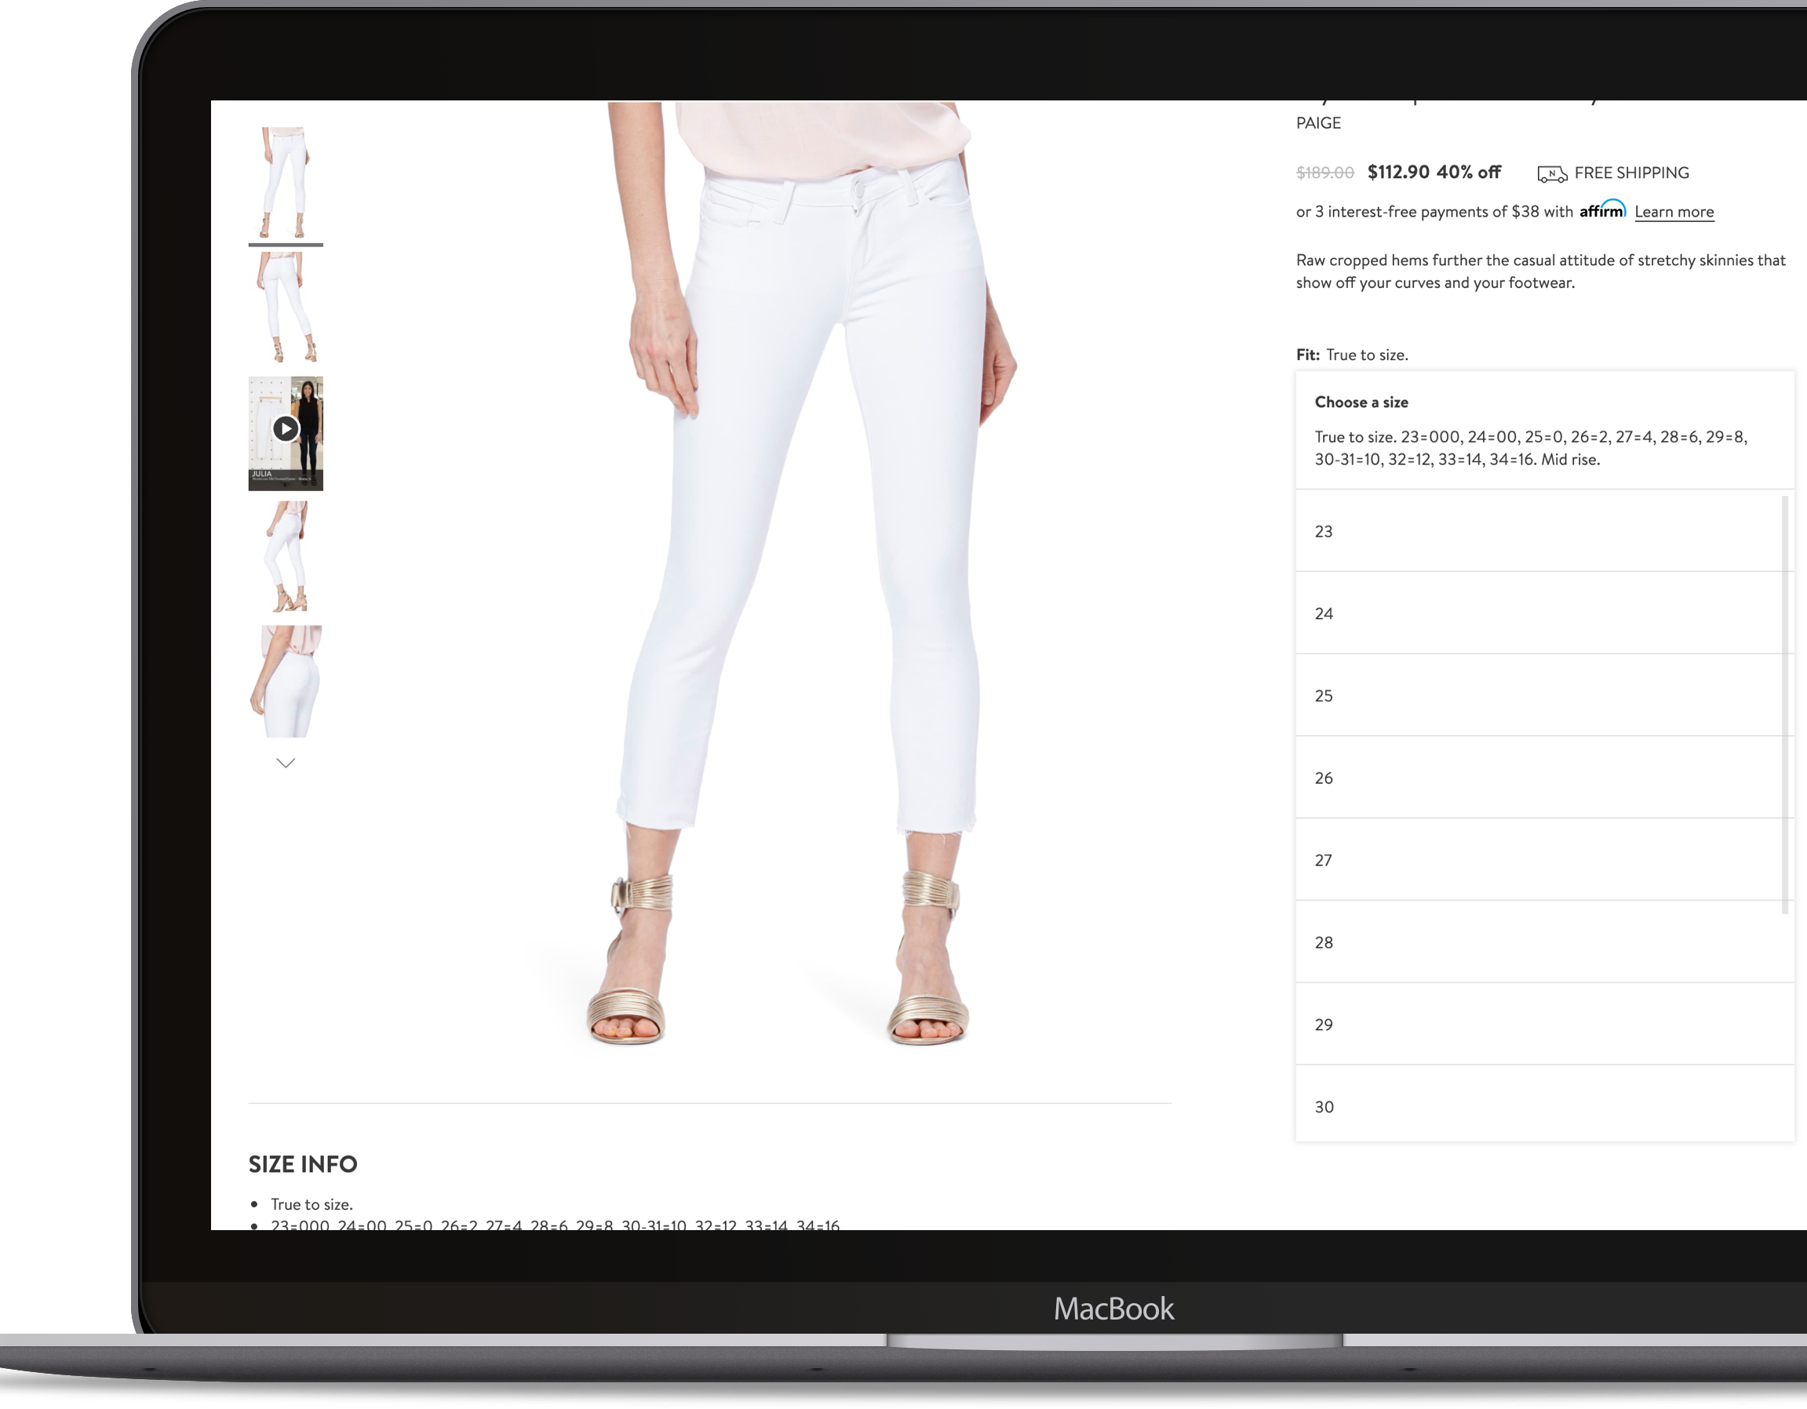
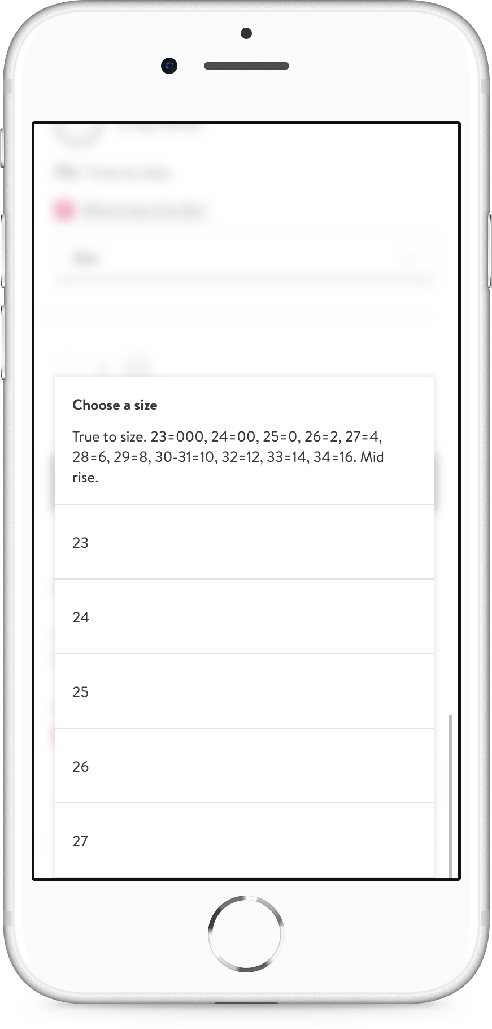
COMPETITOR ANALYSIS
NORDSTROM
INFORMATION
http://www.nordstrom.com
Adaptive Web Design (AWD)
STRENGTHS
Intuitive UI/UX
Minimalist dropdown size information and product detail page shown simultaneously
Product specific size chart
True size recommendation
True Fit Technology on product detail page (Mobile only)
WEAKNESSES
Downloadable PDF file on desktop
No all size page access point

Slide 13
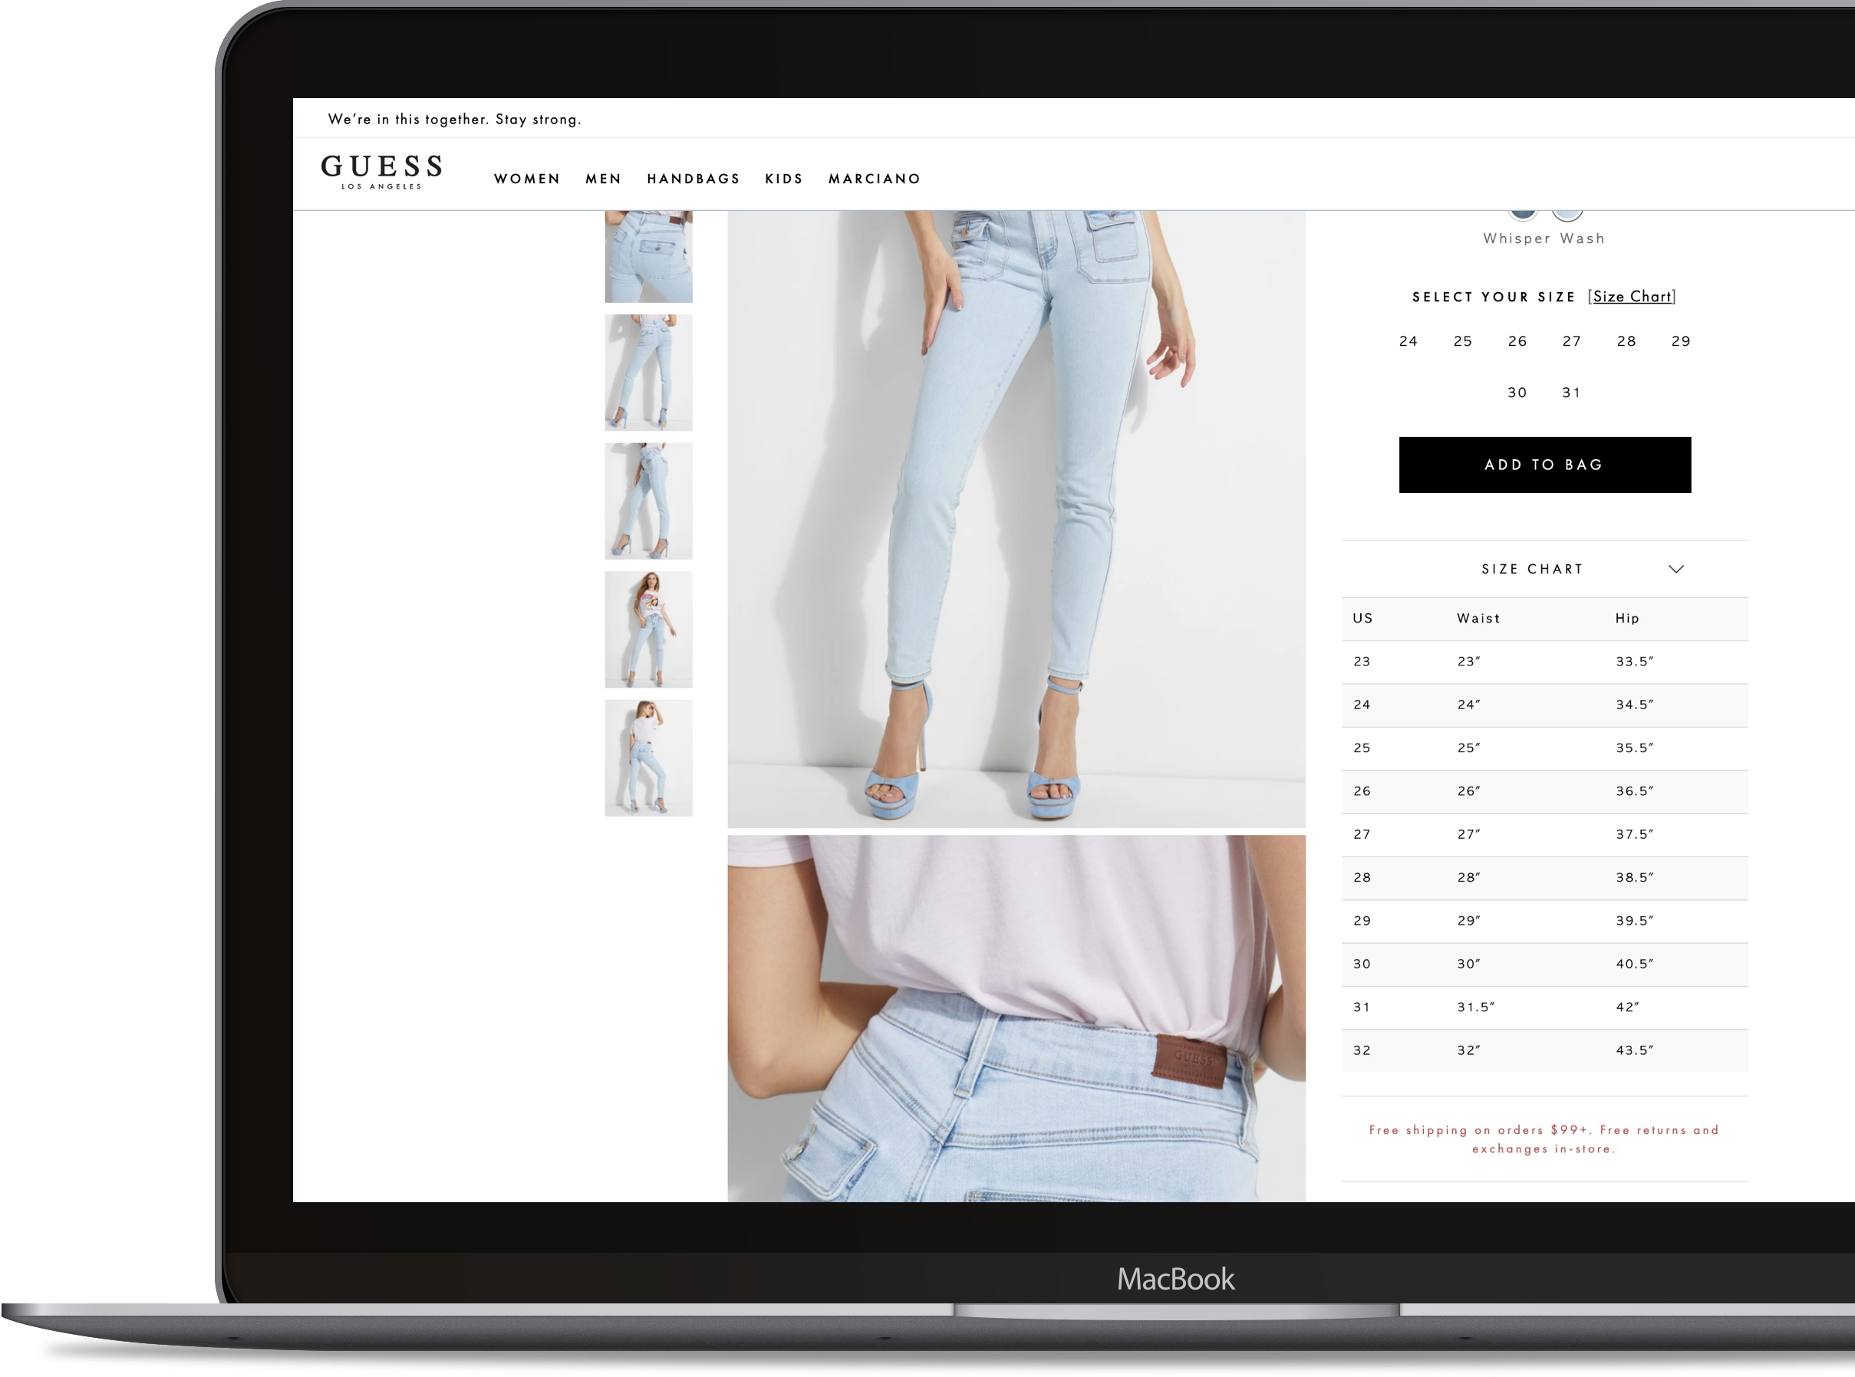
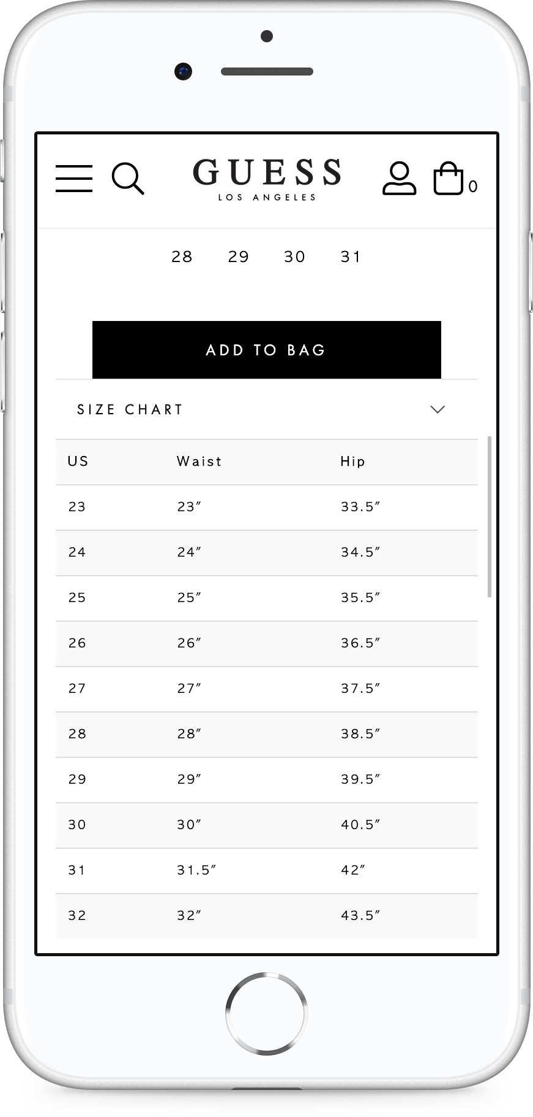
COMPETITOR ANALYSIS
GUESS
INFORMATION
http://www.guess.com
Responsive Web Design (RWD)
STRENGTHS
Intuitive UI/UX
Double exposure size chart access points
Product specific size chart
Zebra Stripes
Inline size chart on product detail page
No inside scroll
WEAKNESSES
No all size chart access point
No Size & Fit curator

Slide 14
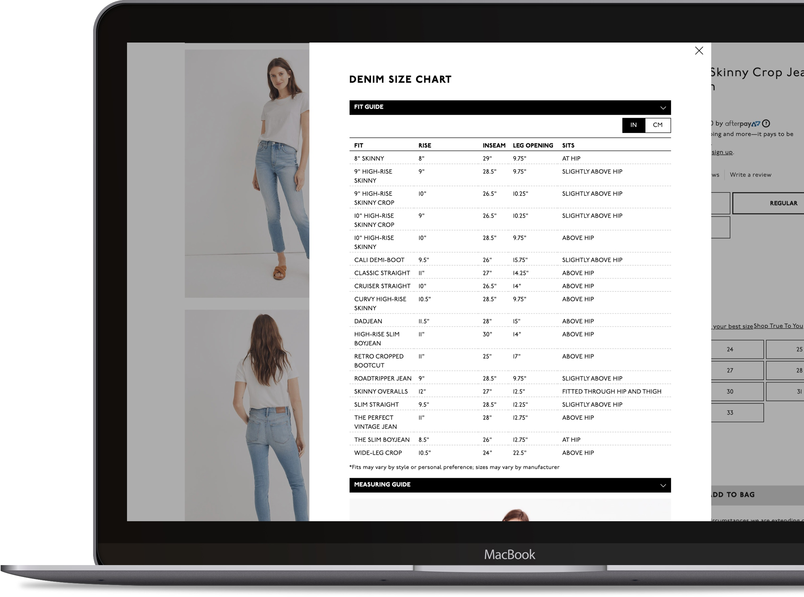
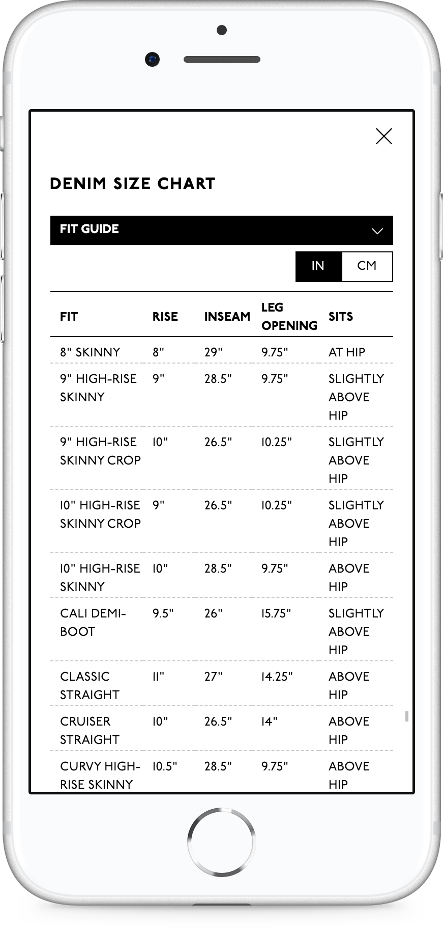
COMPETITOR ANALYSIS
MADEWELL
INFORMATION
http://www.madewell.com
Responsive Web Design (RWD)
STRENGTHS
Visual measuring guide
98% width popup on mobile grab user’s attention
Clear close popup option (Modal Background & “X”)
Measurements both in CM and IN
Vertical scroll with accordion menu
True Fit Technology on product detail page
WEAKNESSES
Unoptimized size information
All caps fonts

Slide 15
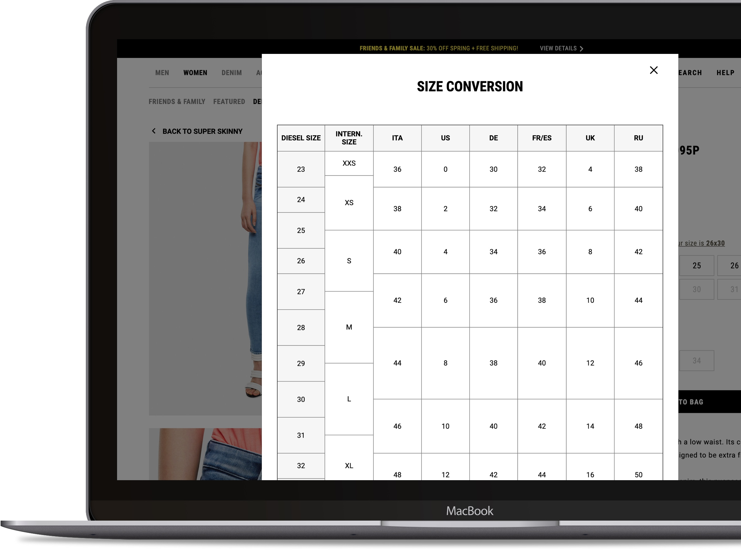
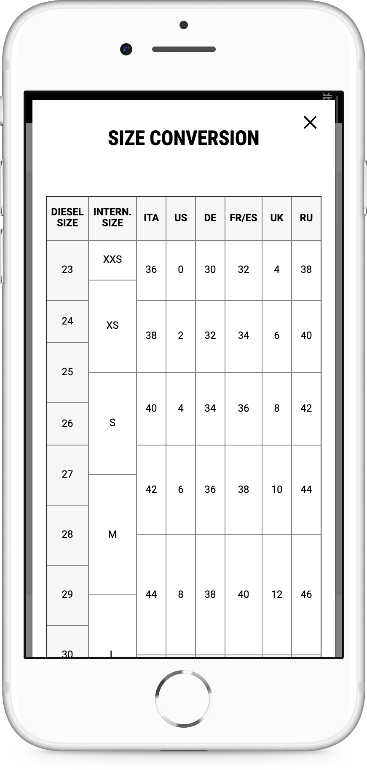
COMPETITOR ANALYSIS
DIESEL
INFORMATION
http://shop.diesel.com
Responsive Web Design (RWD)
STRENGTHS
Product specific size chart
No vertical scroll
98% width popup on mobile grab user’s attention
Clear close popup option (Modal Background & “X”)
Model wearing information on product detail page
Fit Finder Technology on product detail page
WEAKNESSES
No unit of measurement
Modal popup is not at the center of screen

Slide 16
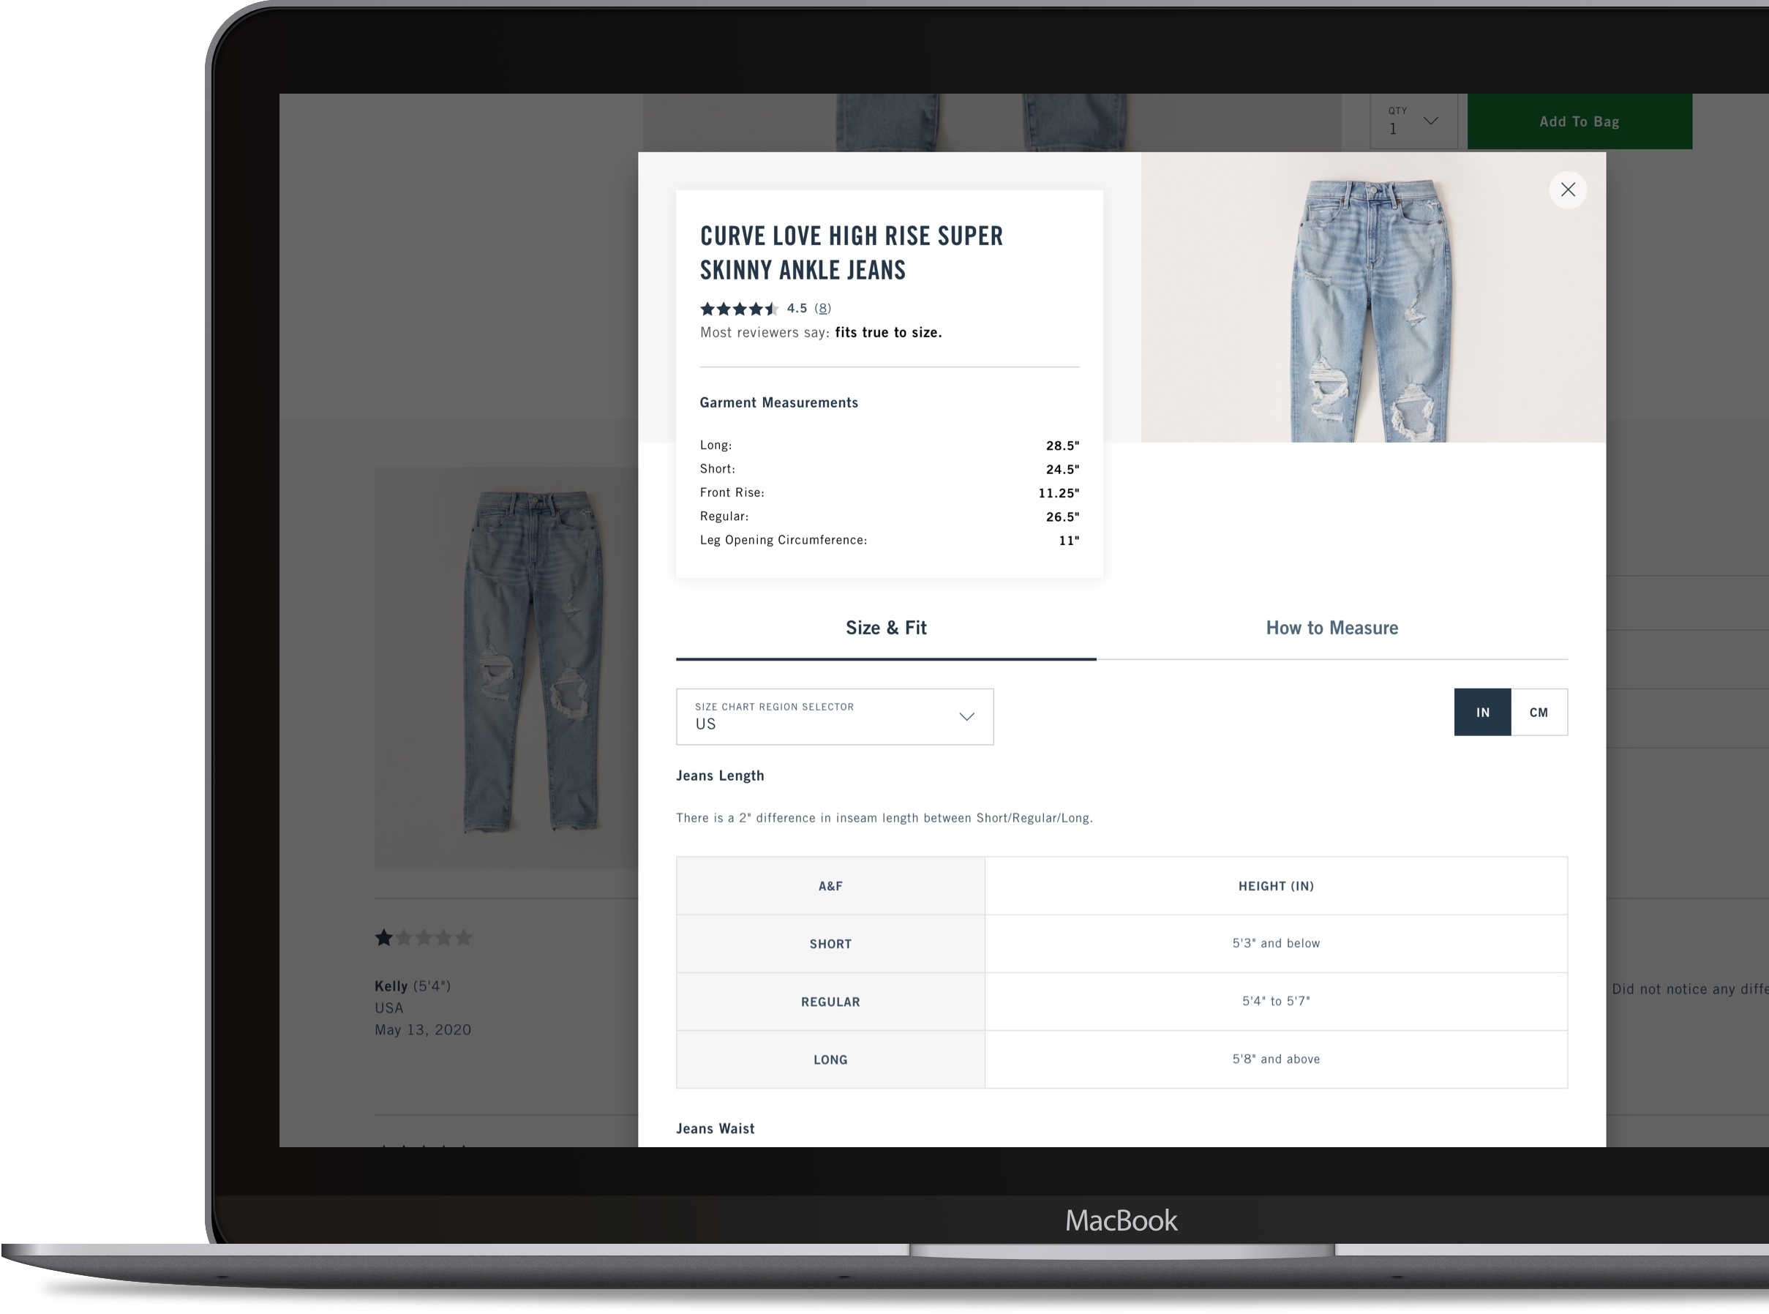
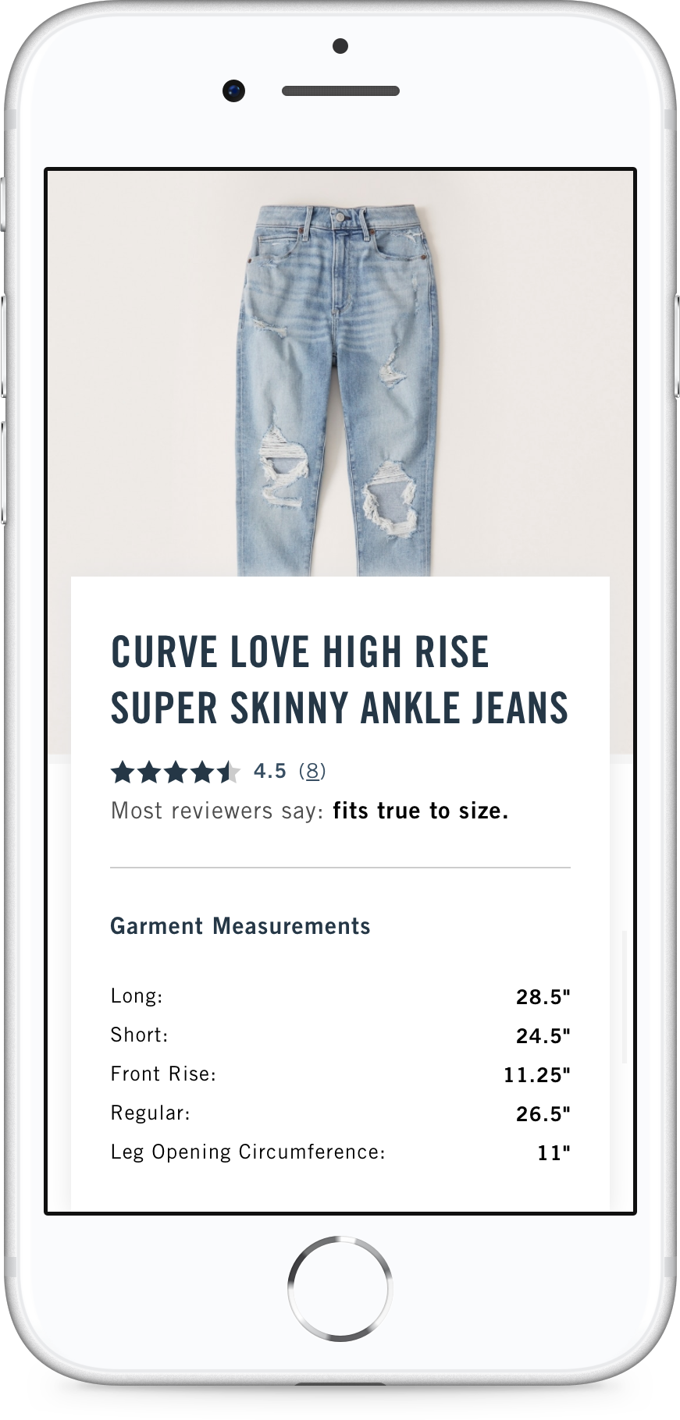
COMPETITOR ANALYSIS
ABERCROMBIE & FITCH
INFORMATION
http://www.Abercrombie.com
Responsive Web Design (RWD)
STRENGTHS
Proper whitespace on the size chart table
Product specific size chart
Size conversion
Measurements both in CM and IN
How to measures info.
Country selection
True size recommendation
WEAKNESSES
Excessive product information

Slide 17
COMPETITOR ANALYSIS
COMPETITORS COMPARISON
STRENGTH
Intuitive UI/UX
Minimalist size information into size dropdown and product detail page simultaneously
Product specific size chart
True size recommendation
True Fit Finder Technology on product detail page
STRENGTH
Intuitive UI/UX
Double exposure size chart access points
Product specific size chart
Zebra Stripes
Inline size chart on product detail page
No inside scroll
STRENGTH
Visual measuring guide
98% width modal popup on mobile
Clear close popup option (Modal Background & “X”)
Measurement both in CM and IN
Vertical scroll with accordion menu
True Fit Technology on product detail page
STRENGTH
No vertical scroll
98% width modal popup on mobile
Product specific size chart
Clear close popup option (Modal Background & “X”)
Model wearing information on product detail page
Fit Finder Technology on product detail page
STRENGTH
Proper whitespace into size chart table
Product specific size chart
Size conversion
Measurement both in CM and IN
How to measures
Country selection
Ture size recommendation
WEAKNESS
Download PDF file on desktop
No all size page access point
WEAKNESS
No all size page access point
No Size & Fit curator
WEAKNESS
Unoptimized size information
All caps fonts
WEAKNESS
No unit of measurement
Modal popup is not center of screen
WEAKNESS
Excessive product information

Slide 18
SIZE GUIDE UI/UX ENHANCEMENT
QUESTIONS

Slide 19
QUESTIONS
WHAT OR WHY?
Who is target audiences?
What’s the purpose of using different serif fonts?
“Women’s Jeans” size is showing first on all products by default. What’s the purpose?
Why will you show all size information?
Do you need the size conversion?
Do you need “Shop Inseam vary by fit”?
Do you have any plan to change Inseam to Length?
Is ”Denim Glossary” on the size guide necessary?

Slide 20
SIZE GUIDE UI/UX ENHANCEMENT
SOLVE THE
PROBLEMS

Slide 21
SOLVE THE PROBLEMS
OUR GOALS
SHORT TERM
Overview
Keep current size information and structure
Update UI/UX to be more mobile friendly
Fonts
Use common web fonts or legible Lucky Brand’s own branding web fonts (San-Serif)
Intuitive Information
Optimize size information
Show the accurate size information related to product* (*Need to discuss with Dev. Team)
Vertical Scroll
This is most comfortable and something that the users are used to already, they all use Facebook and Instagram, so they know that the apps and websites go from up to down – nothing new to learn.
RECOMMENDATION – LONG TERM
Overview
Revamp PDP & Size Guide with new UI/UX to improve user engagement, reduce inaccurate size selection, and decrease return rate
Reduce unnecessary click behavior
Minimalize size information
Size & Fit Curator
Fit Finder Technology (https://www.fitanalytics.com/fit-finder)
True Fit Technology (https://www.truefit.com)
True Size recommendation based on Review
Revamp PDP
Optimize PDP
Model wearing information
Size Conversion
Measurements both in CM and IN
True to Size Recommendation
Implement on PDP & Size Guide

Slide 22

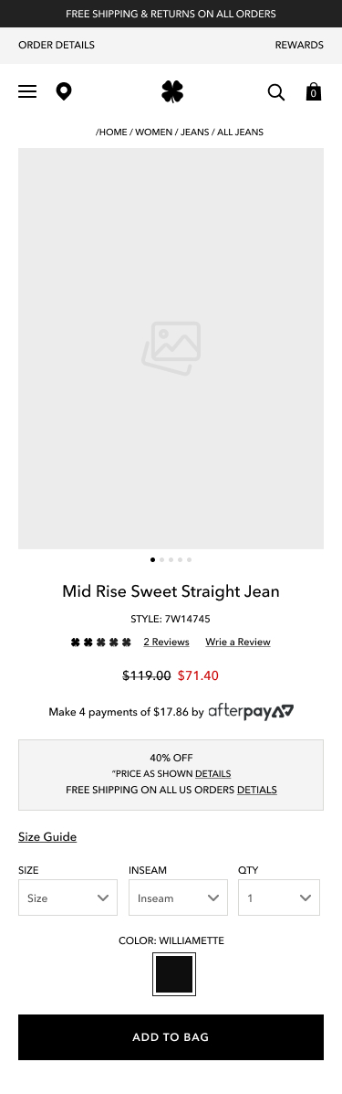
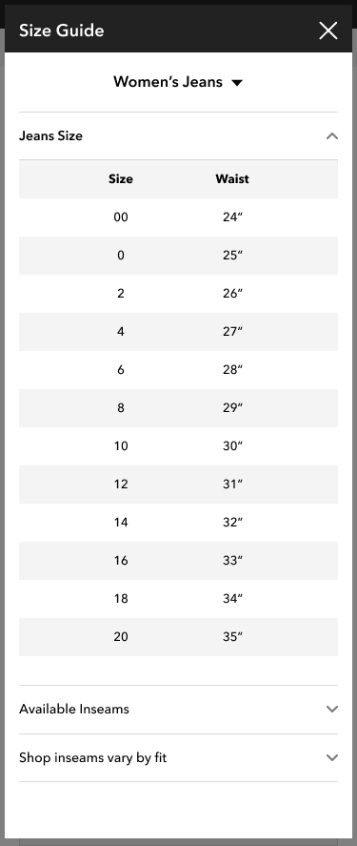
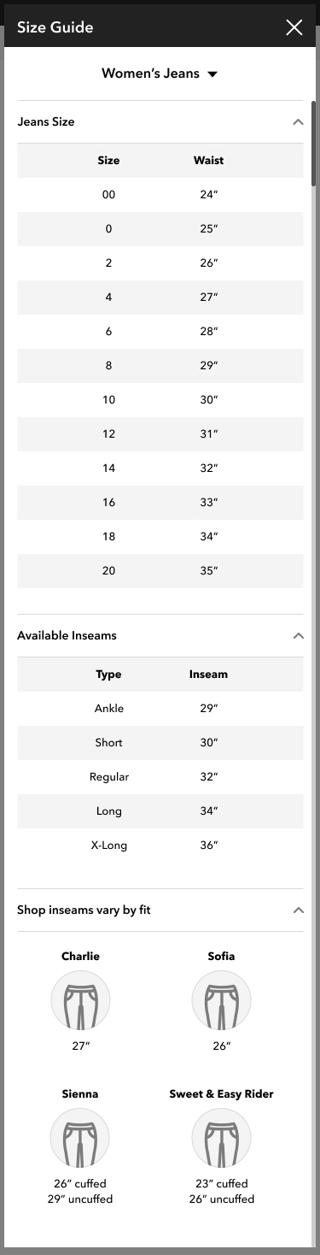
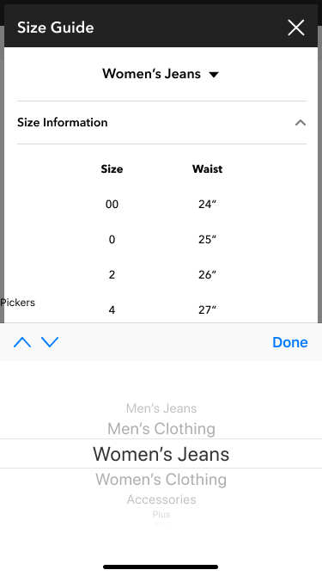
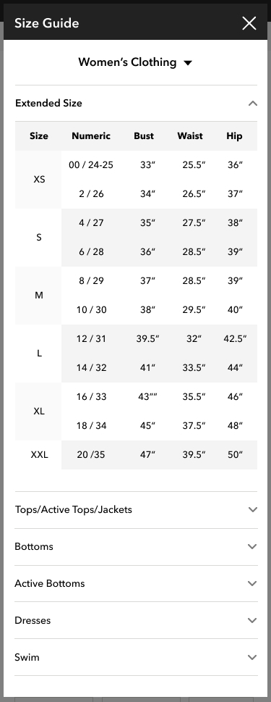
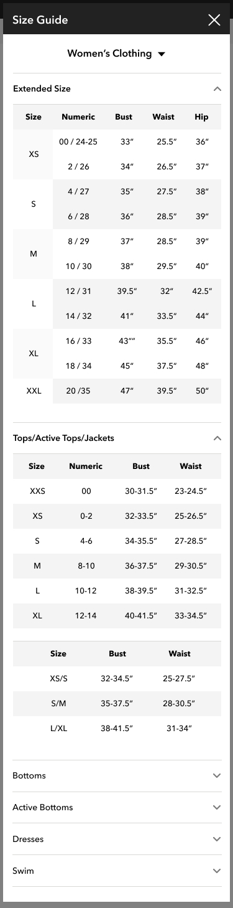
SOLVE THE PROBLEMS
MOBILE WIREFRAME – SHORT TERM
Download PDF file
2
1
Size Guide entry point on PDP (Product Detail Page)
3
4
7
2
Modal popup size: 98%
Size Guide title with ”X” are sticky
3
Dropdown navigation
4
Accordion dropdown and Zebra stripes on contents
First dropdown is opened by default
6
5
Visual contents style
6
iOS UI picker for navigation
1
8
7
Added Extended Size
5
8
Different size variation

Slide 23
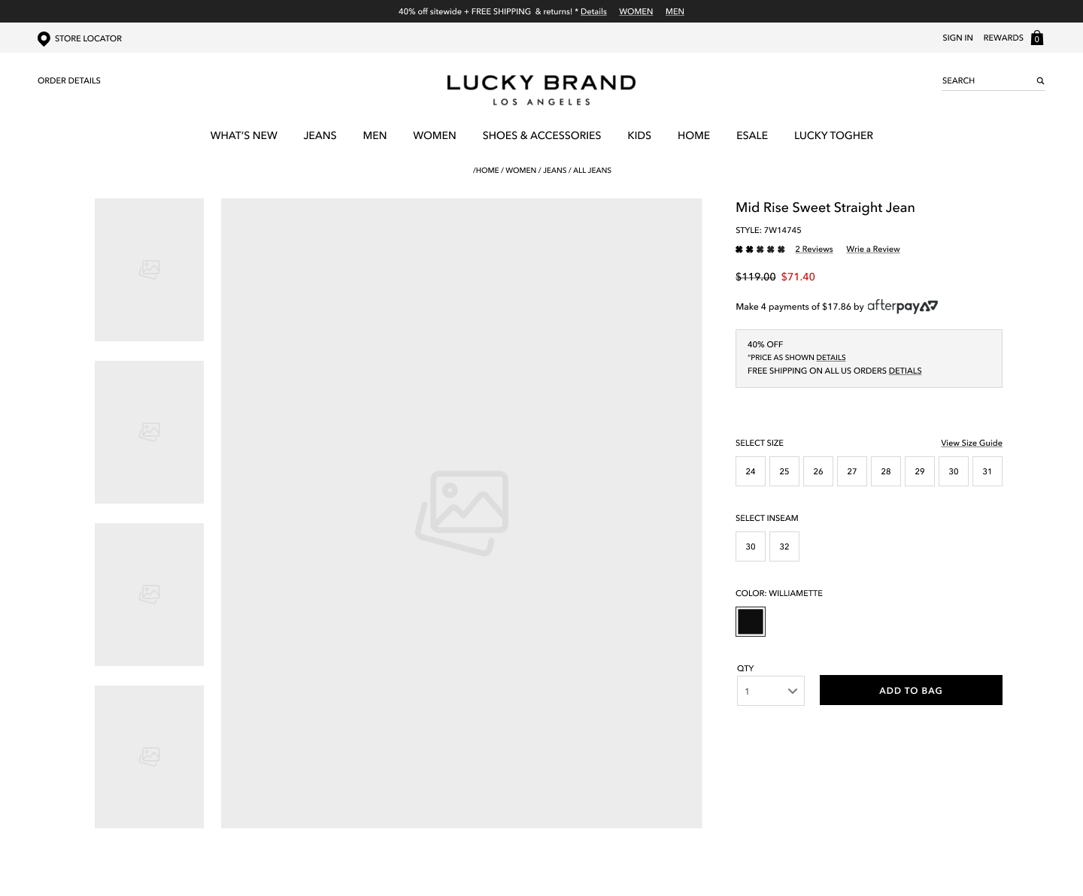
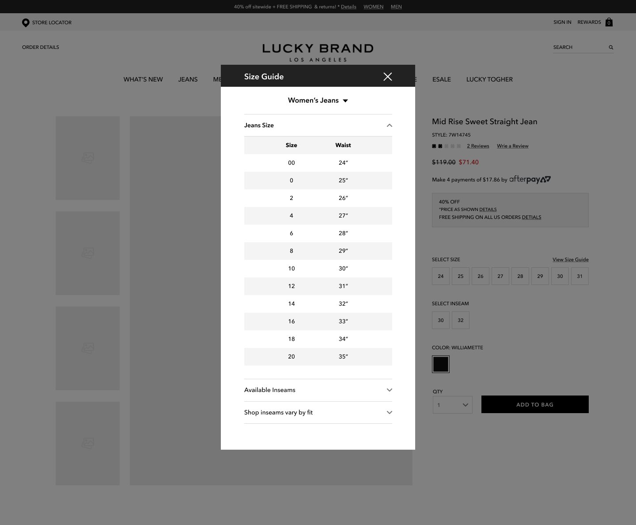
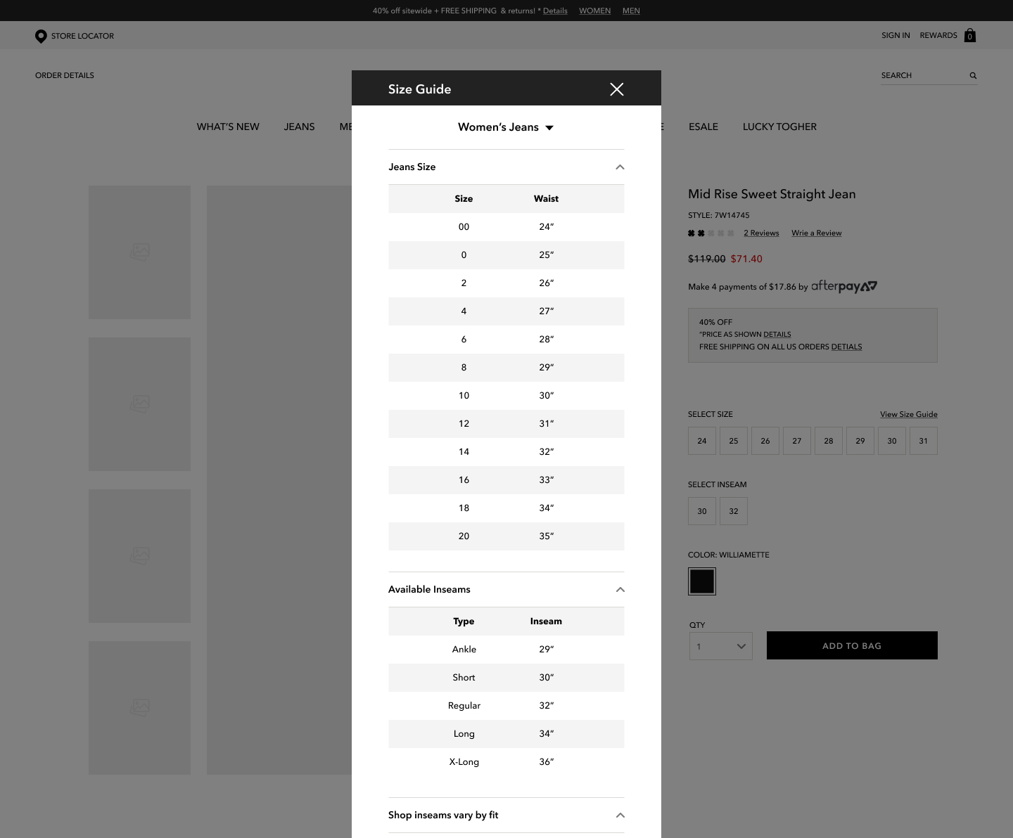
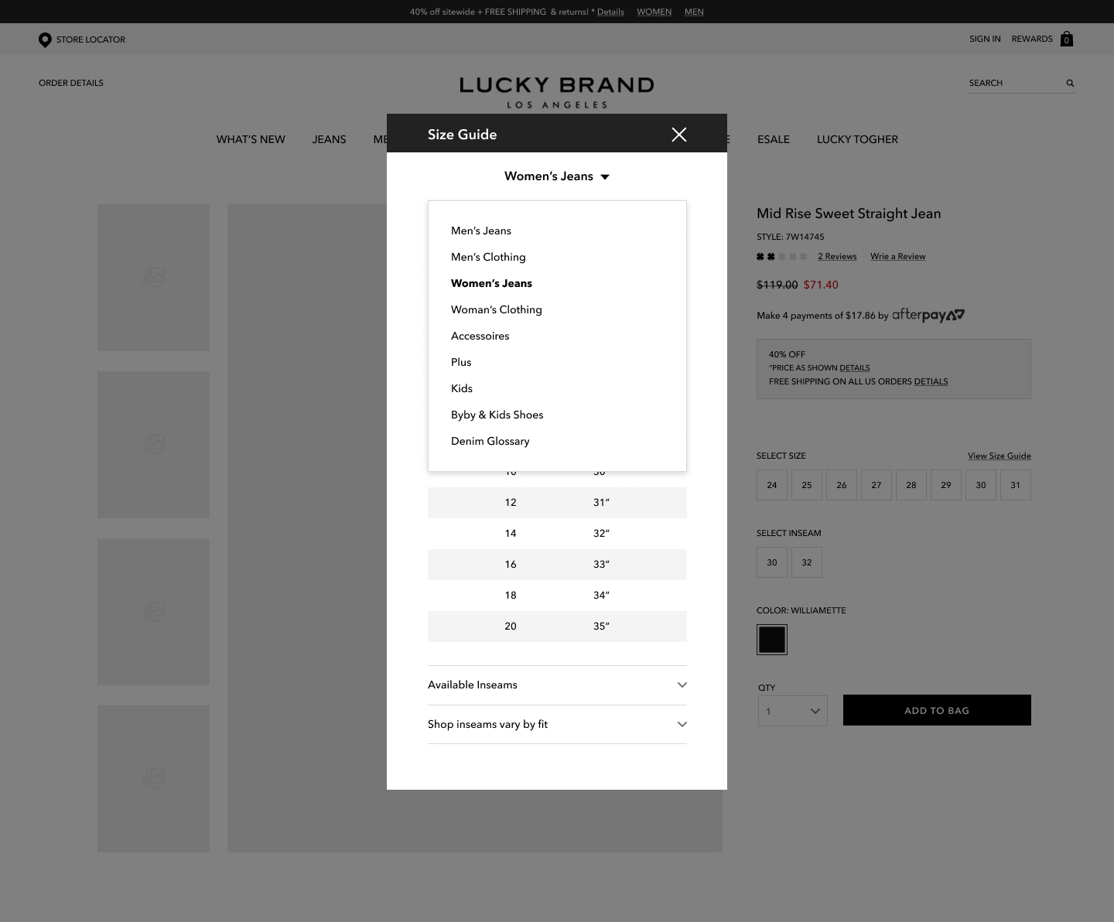
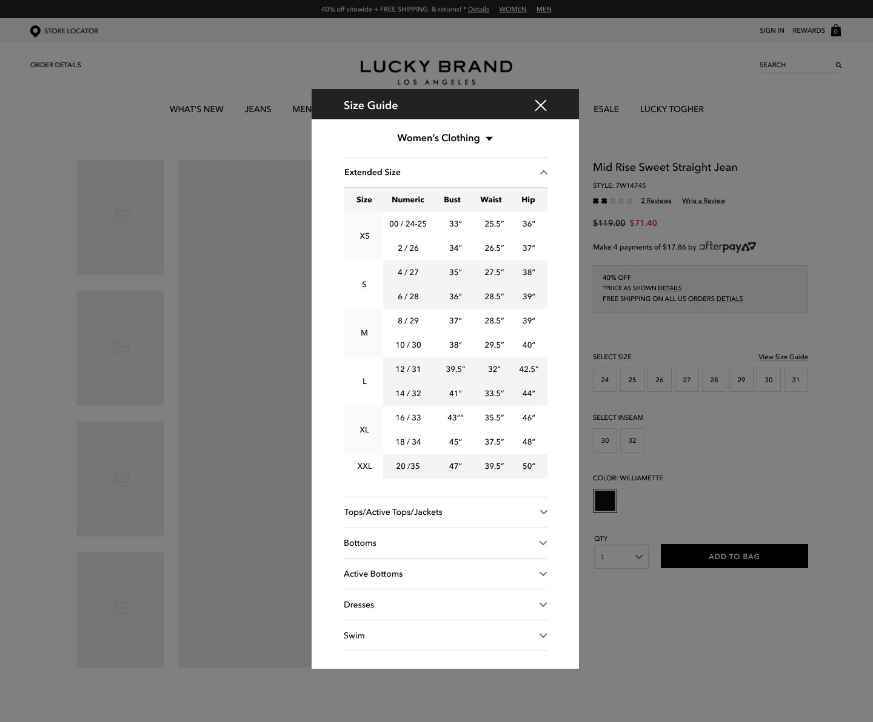
SOLVE THE PROBLEMS
DESKTOP WIREFRAME – SHORT TERM
1
Size Guide entry point on PDP (Product Detail Page)
2
2
Modal popup is at the center of screen
1
3
3
Clickable modal background
4
Dropdown navigation
4

Slide 24
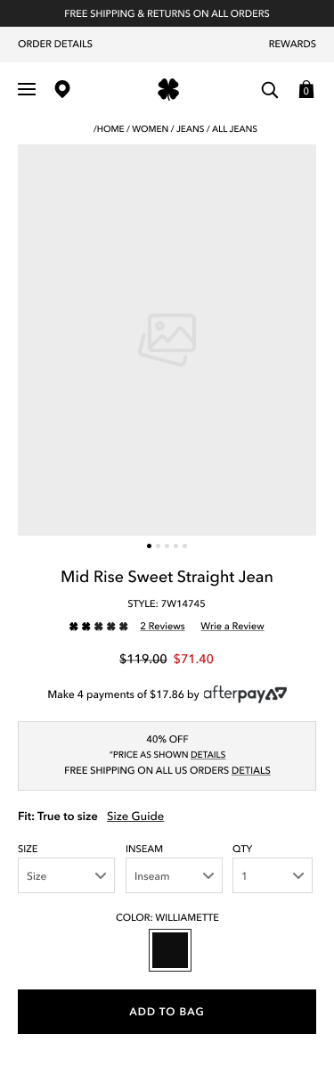
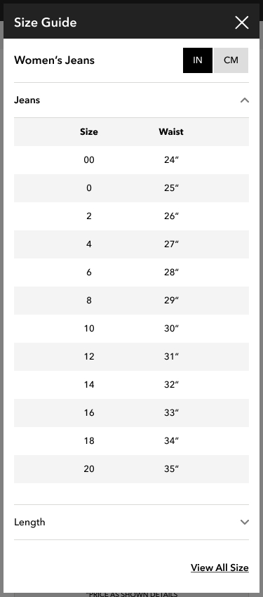
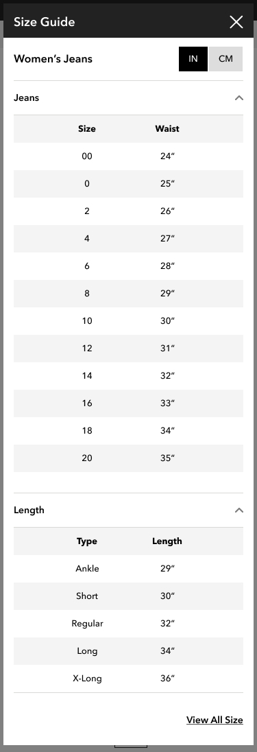
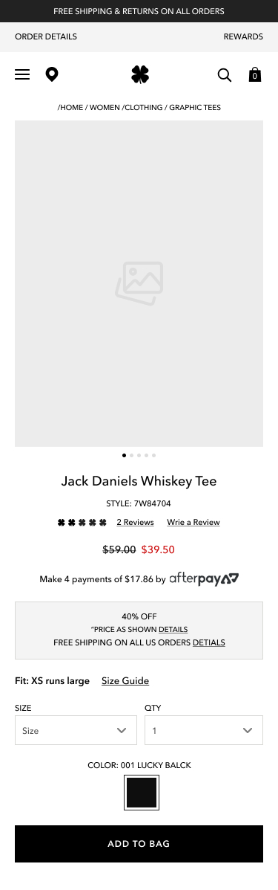
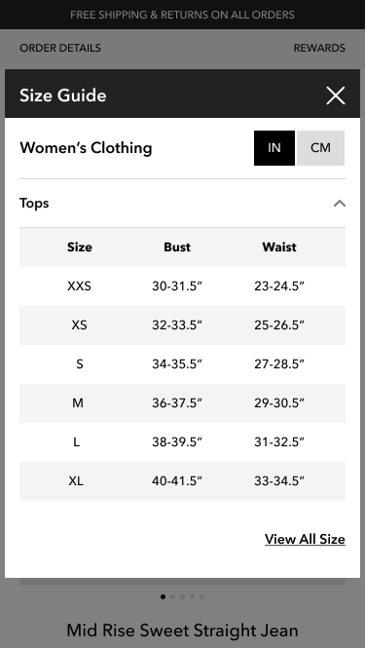
SOLVE THE PROBLEMS
MOBILE WIREFRAME – ENHANCEMENT
Download PDF file
2
1
Added True to Size
3
4
8
2
Modal popup size: 98%
Size Guide title with ”X” are sticky
3
Size Conversion CTA
4
Show specific product size information
5
Change Inseam to Length
5
6
View All Size Link (Go to All Size Guide page)
1
7
7
Added True to Size recommendation
6
8
Title and size are matched with product (Tee)
Show specific product size information (Women>Top)

Slide 25

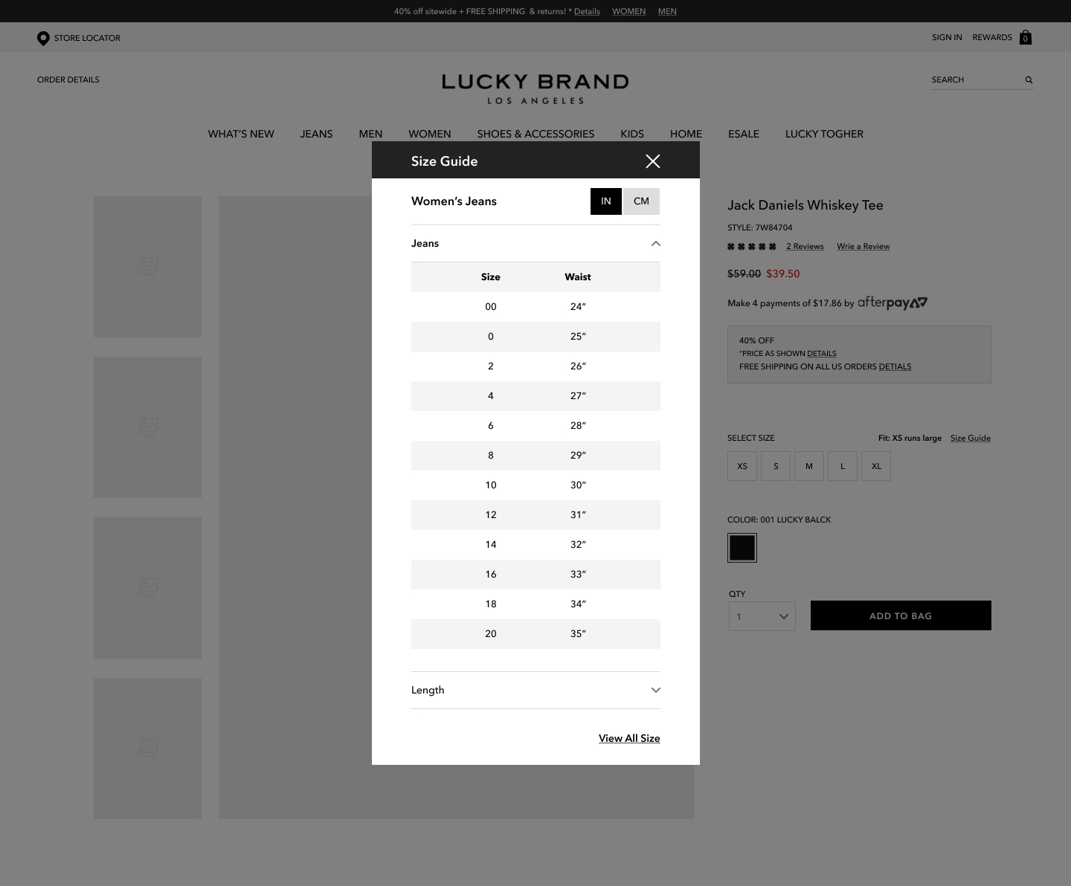
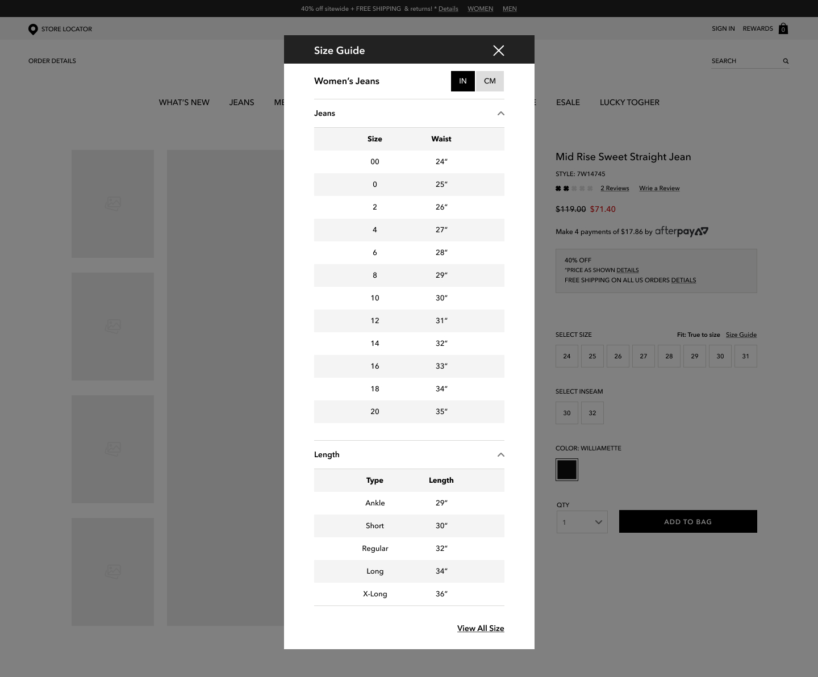
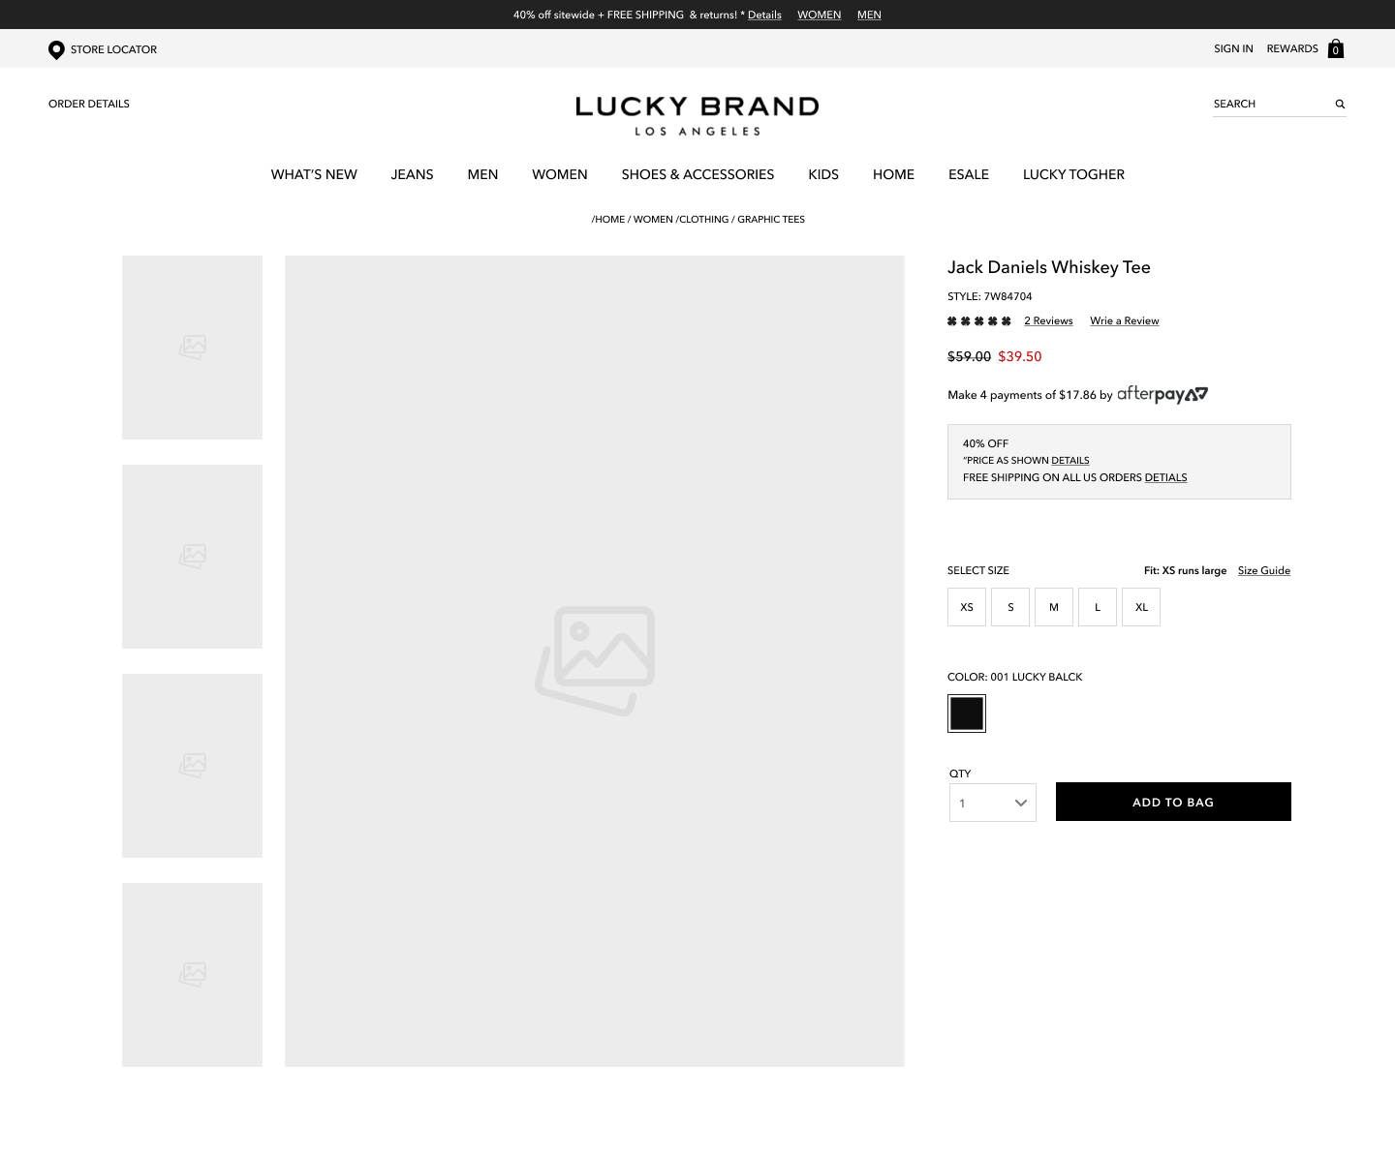
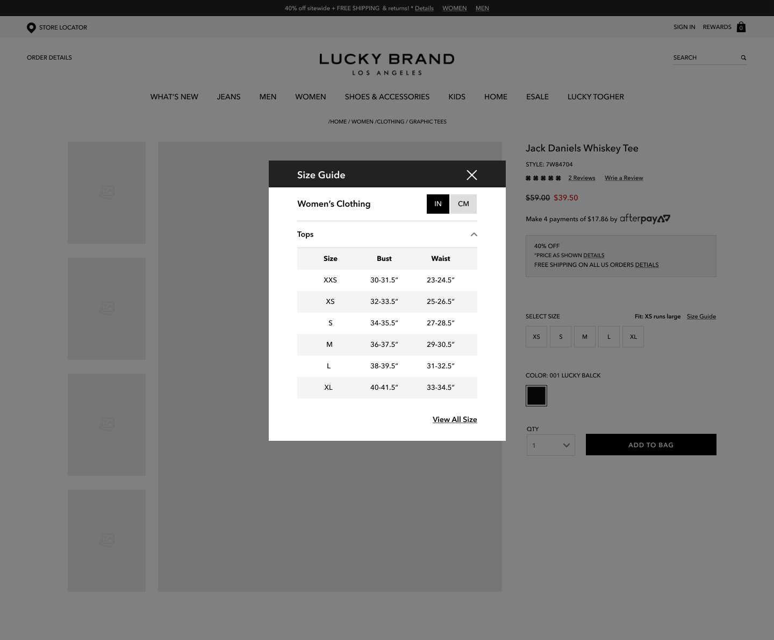
SOLVE THE PROBLEMS
DESKTOP WIREFRAME – ENHANCEMENT
1
Added True to Size
2
3
2
Modal popup is at the center of screen
1
5
3
Size Conversion CTA
6
4
View All Size Link
(Go to All Size Guide page)
4
5
Clickable modal background
6
Change Inseam to Length
7
8
Added True to Size recommendation
7
8
Title and size are matched with product (Tee)
Show specific product size information (Women>Top)

Slide 26
ELISHA LEE – UI/UX DESIGNER
3 MONTH
ROADMAP

Slide 27
ELISHA LEE – UI/UX DESIGNER
THREE MONTHS ROADMAP
1st Month
2nd Month
3rd Month
P.M PERSPECTIVE
Prioritize projects
Implement Project Management System such as Jira* (May vary depending on decisions)
UI PERSPECTIVE
Create Lucky Brand UI Style Guide
Create wireframes
UI PERSPECTIVE
On-going create wireframes
Redesign UI with new style guide
UX PERSPECTIVE
Competitor Analysis
Solve the paint points
Research current e-Commerce trends
UI PERSPECTIVE
Improve current UI such as misalignments issue
UX PERSPECTIVE
Current Lucky Brand website analysis
Survey Internally*
Find the pain points
DEV. PERSPECTIVE
On-going Front-End enhancement
On-going SEO improvement
DEV. PERSPECTIVE
Front-End enhancement
SEO improvement

Slide 28
SIZE GUIDE UI/UX ENHANCEMENT
THANK YOU
ELISHA LEE
UI/UX DESIGNER
April 17, 2020

